Slide 1



TREADPATH
Fall '24 Capstone Michelin Team

Slide 2
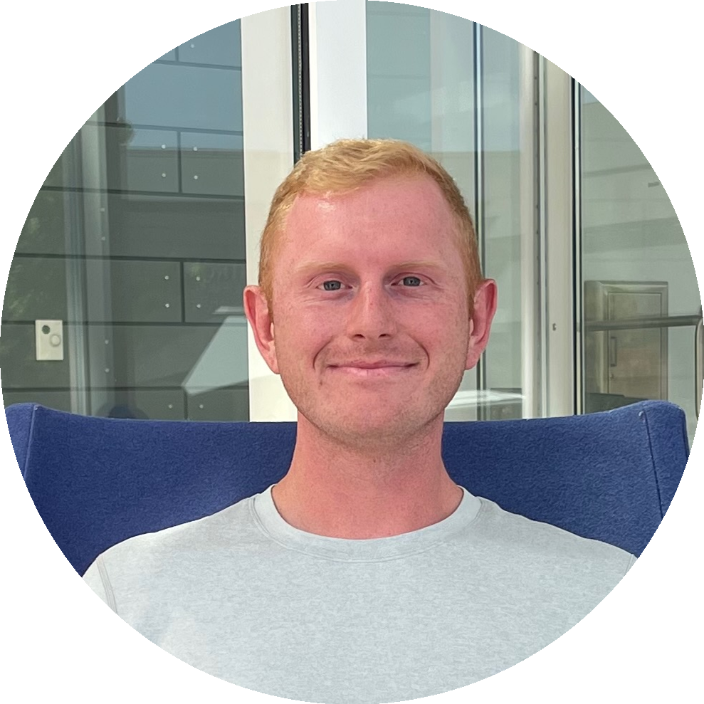
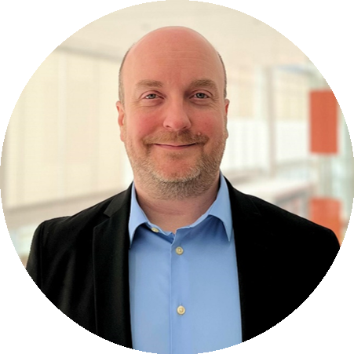
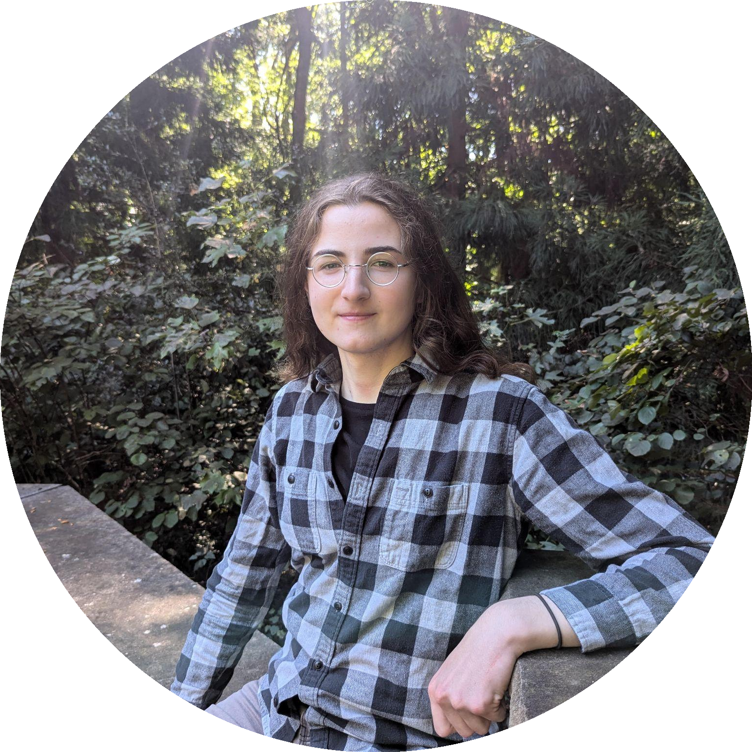
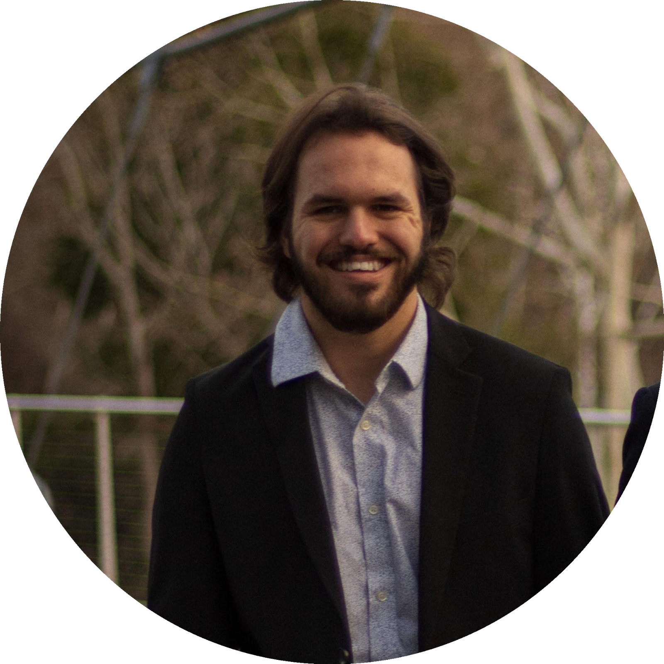
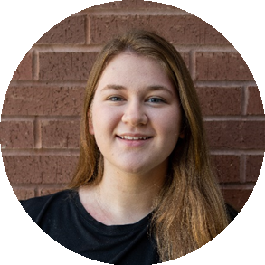

Meet the Team
AJ Garner ​Team Lead
Troy Butler
Expert Relations & Research
Jacob Cox
RAG Developer
Carson Crockett Semantic Analysis Developer
Caroline Baker UI Design & Research

Slide 3
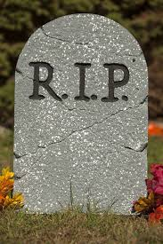

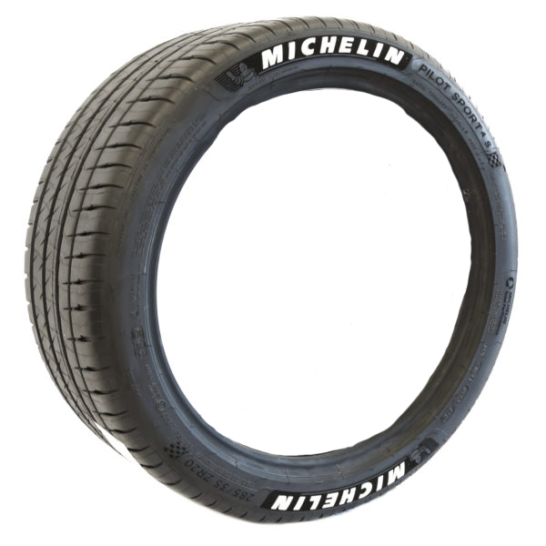
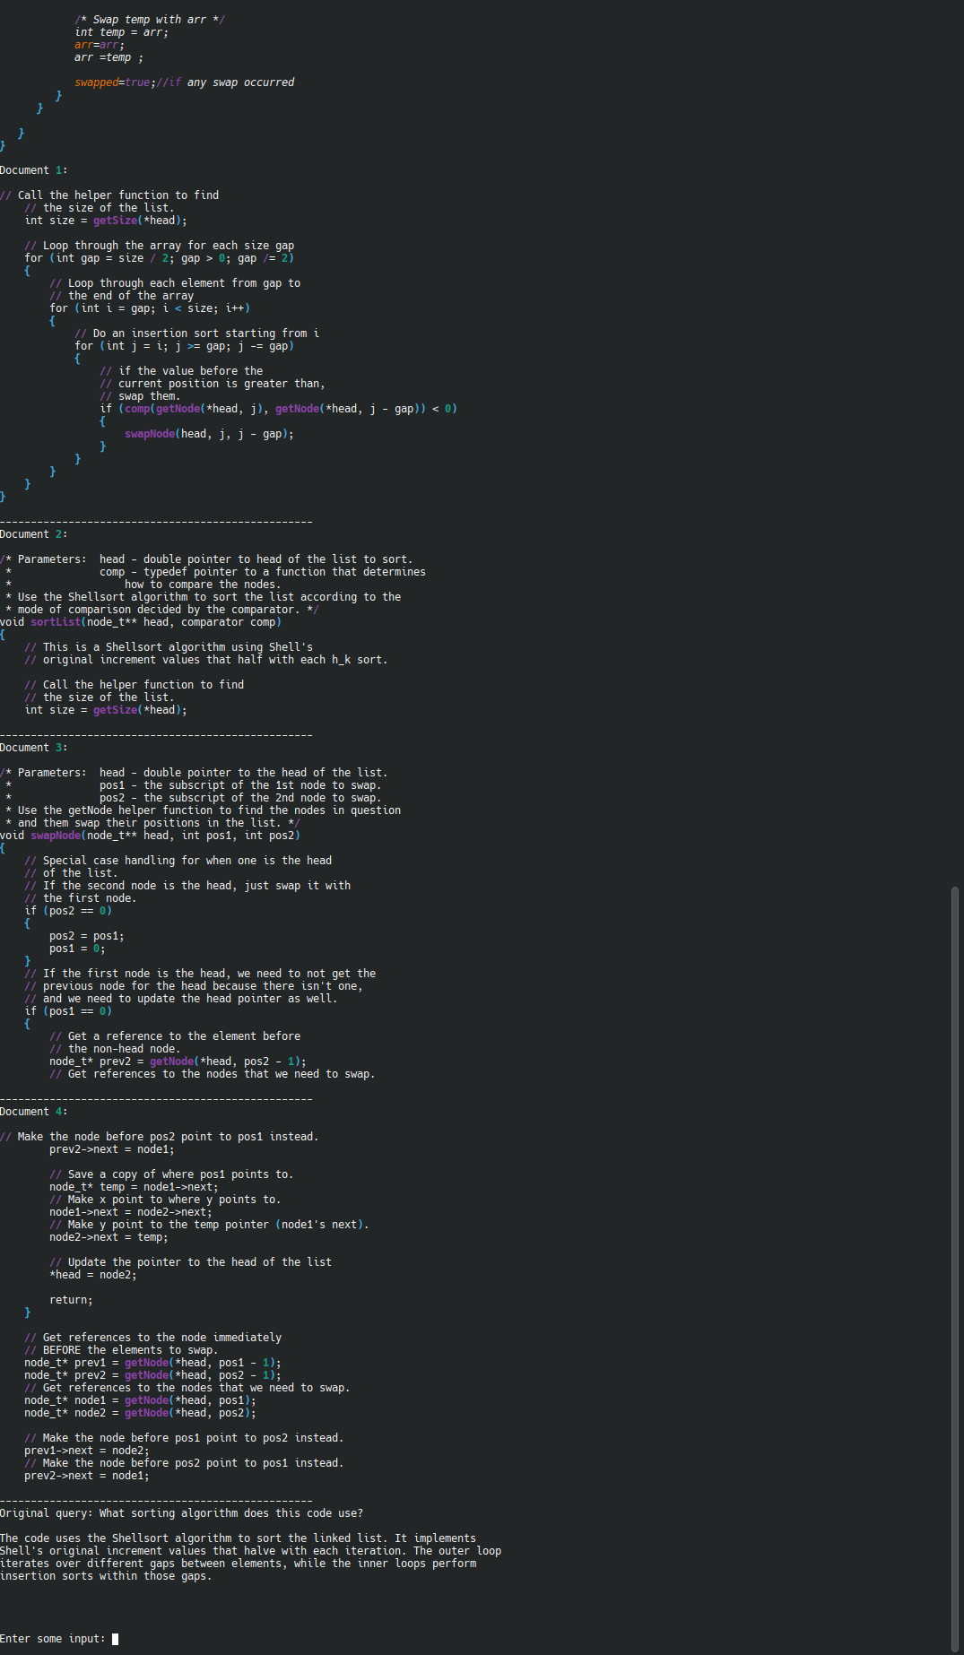
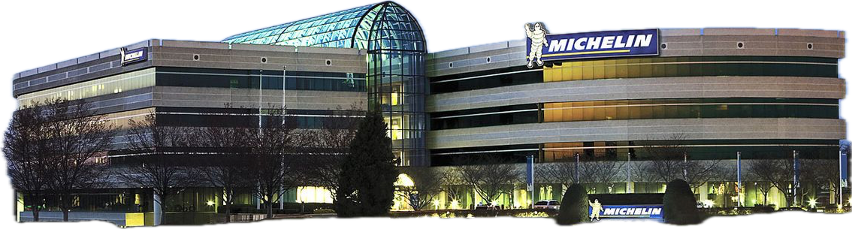
Project Overview
Can AI Do It?
Requiescat in pace

Slide 4
Business Logic
Michelin
IF ACCTFILE-STATUS = ‘00’
MOVE 0 TO APPL-RESULT
PERFORM 1100-DISPLAY-ACCT-RECORD
ELSE
IF ACCTFILE-STATUS = ‘10’
MOVE 16 TO APPL-RESULT
ELSE
MOVE 12 TO APPL-RESULT
END-IF
END-IF
Customer
Legacy System
Updated System

Slide 5
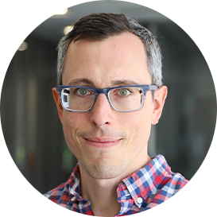
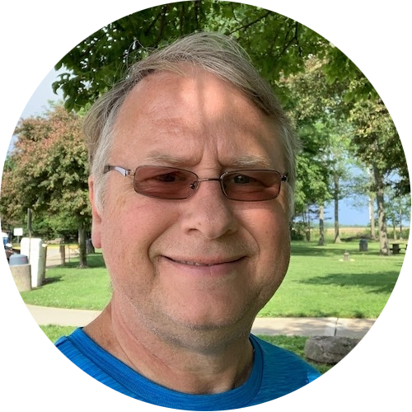
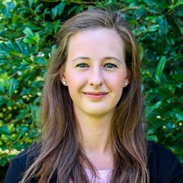
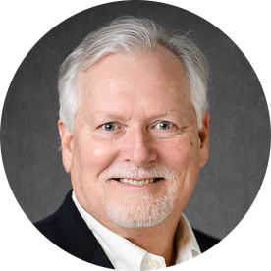
Faculty Consultation
Dr. Carl Ehrett
Watt Family Innovation Center
Director of Applied Machine Learning
Dan Wooster
School of Computing
Professor of Practice
Dr. Paige Rodeghero
School of Computing
Assistant Professor
Dr. Russell Purvis
College of Business
Professor

Slide 6
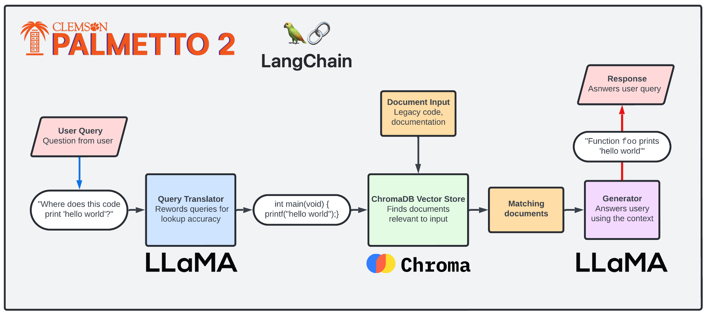
System Overview

Slide 7
Summary Document Generation
Section Summary
RAG Document Datastore
COBOL
System
File
LLM
RAG Retrieval
File Summary

Slide 8
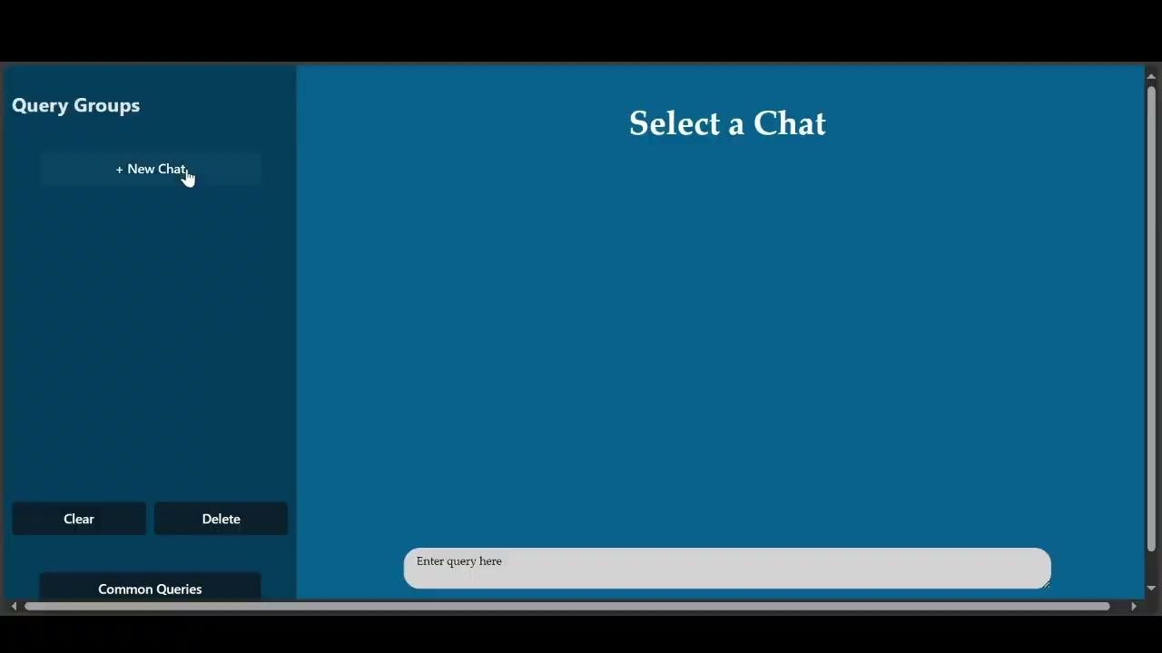

Slide 9


THANK YOU!

